Slide 1
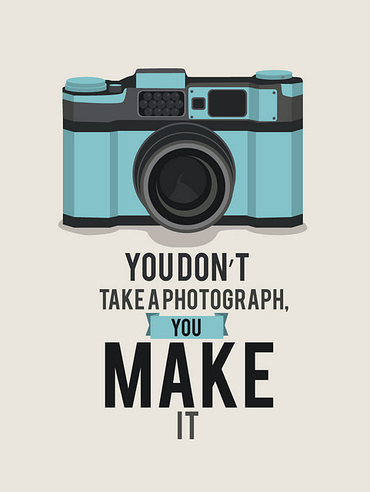
ATAR Design: Photography
Revision Session

Slide 2
Design Elements

Slide 3
Principles of Design

Slide 4
Colour

Slide 5
Typography

Slide 6
Bringing it together…

Slide 7
Design methods (RIIDE)

Slide 8
Communication Model

Slide 9
Semiotics and Visual Codes

Slide 10
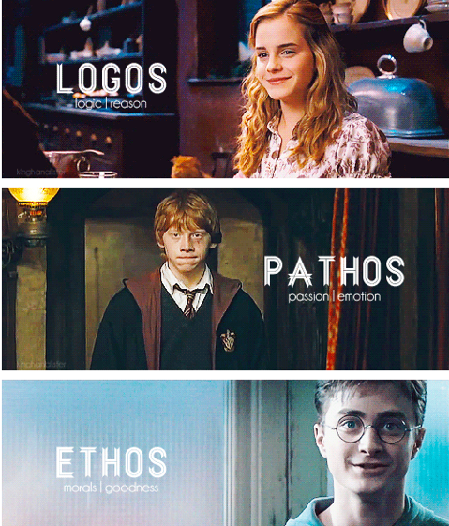
Persuasive Techniques
Shock
Humour
Emotion
Metaphor
These are used
in order to appeal
to audiences in the
following ways;

Slide 11
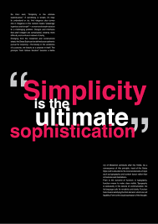
Form Follows Function

Slide 12
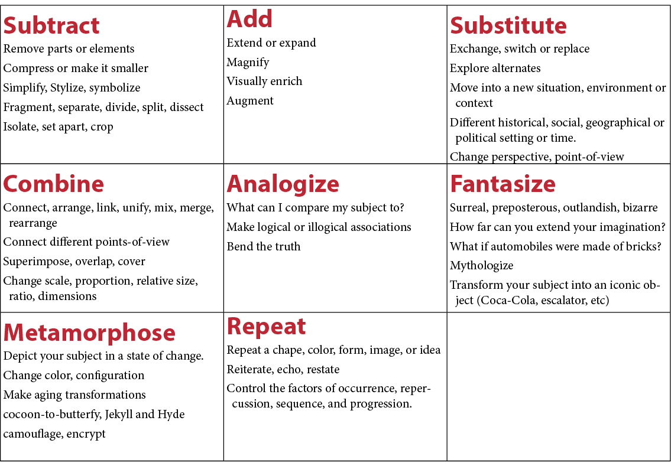
Synetics/ SCAMPER

Slide 13
Production Planning Cycle

Slide 14
Stakeholder Needs

Slide 15
Occupational Health and Safety

